Slide 1
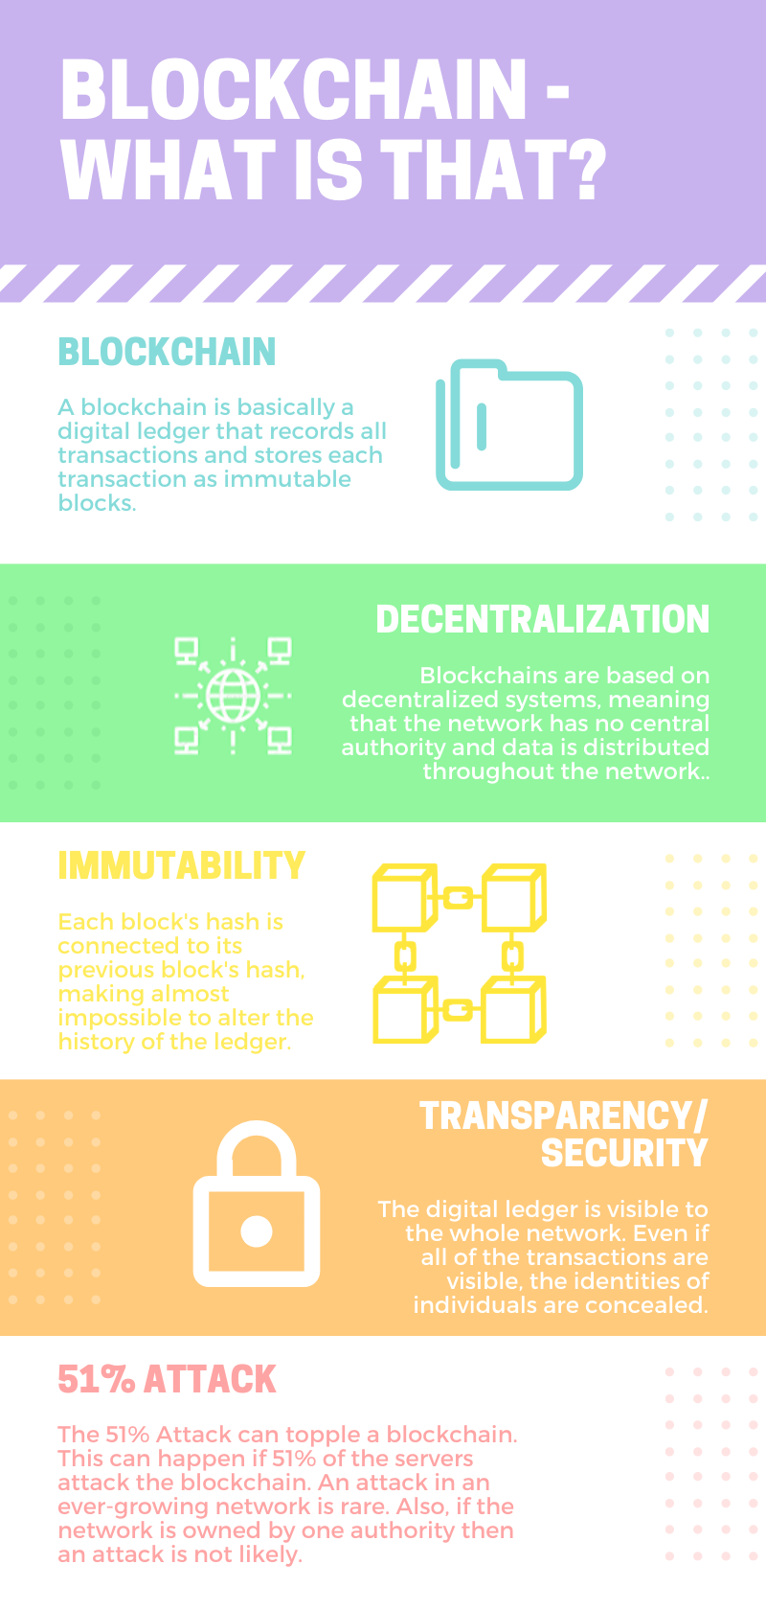
RUNNING AN AUCTION USING BLOCKCHAIN
Running the Auction
Auctioneer
An auctioneer is selected; they open the auction and are the only ones that can close the auction
Opening
An auction is opened by the auctioneer and the currency is set to ethers
Seller
A different account is selected for the seller. The seller sets the minimum bid.
Bidder
The remaining accounts are bidders. To bid, a bidder account is selected and a bid is placed.
Bid
After each bid, the bidder gives the auctioneer the sum and the sum collected from the previous bid is returned to its respective bidder.
Figure 1 (above): What is Blockchain? Blockchain is a digital ledger that allows encrypted information to be transferred peer to peer through a decentralized system. Blockchain can be used for many different things besides CryptoCurrency.
Figure 2 (right): These are the steps for how the auction is run. The auctioneer opens the auction, then there is a cycle of bidders placing their bids, and at the end the auctioneer closes the auction.
Closing
To close the auction, the auctioneer must be selected. The latest bidder then pays the seller the second-highest bid. The auction is closed.
How Does a Blockchain Work?
Someone requests a transaction.
The block is sent out to the network.
The block is permanently added to the blockchain.
1
3
5
2
4
6
The transaction is represented as a block.
The network approves the block.
The transaction is complete!
Figure 3 (above): These six steps describe the overall process of adding a transaction to the ledger of the blockchain.

Slide 2
Introduction
Conclusion
Blockchain is a fairly new technology that emerged with the introduction of the famous CryptoCurrency BitCoin. But there are many uses of blockchain besides just CryptoCurrency, for example, Walmart has a blockchain that allows them to track their produce and the United States Postal Service has placed a patent to use blockchain as an identity verification measure. Blockchain is used for tasks as simple as securing databases to as complicated as monitoring carbon offsets. It can also be used to manage an auction and would be able to safely transfer money, keep identities of bidders secure, and keep an accurate ledger of the bids.
The overall result of this project was that a smart contract was built for a blockchain-based auction that uses components of a minimum-bid auction merged with a component of a Vickrey auction. The auction lets the seller set the minimum bid and the highest bidder gets to pay the second-highest bid. Albeit most of the functions have to be manually selected, such as changing the bidder, the auction runs smoothly. In the end, the project met the criteria set for it, which was to set up a functioning auction and add the extra Vickrey auction component.
Future Research
Procedures
Blockchain has countless possibilities, but for this specific blockchain-based auction, future research would include:
being able to use third-party timers to restrict the amount of time the bidders have to bid
to automate the closing of the auction if said time runs out. This would give a more auction-like feel to the project.
Another thing to possibly work on in the future is to format a front-end website for this auction where different people are the bidders and they decide the bids, instead of the bidders having to be manually selected.
Blockchains were researched to understand what they really are and how they work. The IDE Ethereum and the language Solidity were also researched.
Blockchain-based auction code was used to set a foundation in order to add or remove features of the auction.
The auction ran in this way:
the seller set the minimum bid
then bidders gave their bids
when the bidding stopped, the auctioneer closed the auction
The auction was run multiple times to test if the right amount of money was being transferred to the right accounts.
All photos, graphs, and charts are created by the researcher.

